Slide 1

Rationality
Notes on Behavioural Economics
Jason Collins

Slide 2
Rationality
economics rationality ≠ lay rationality

Slide 3
Completeness
An agent can always compare any two options

Slide 4
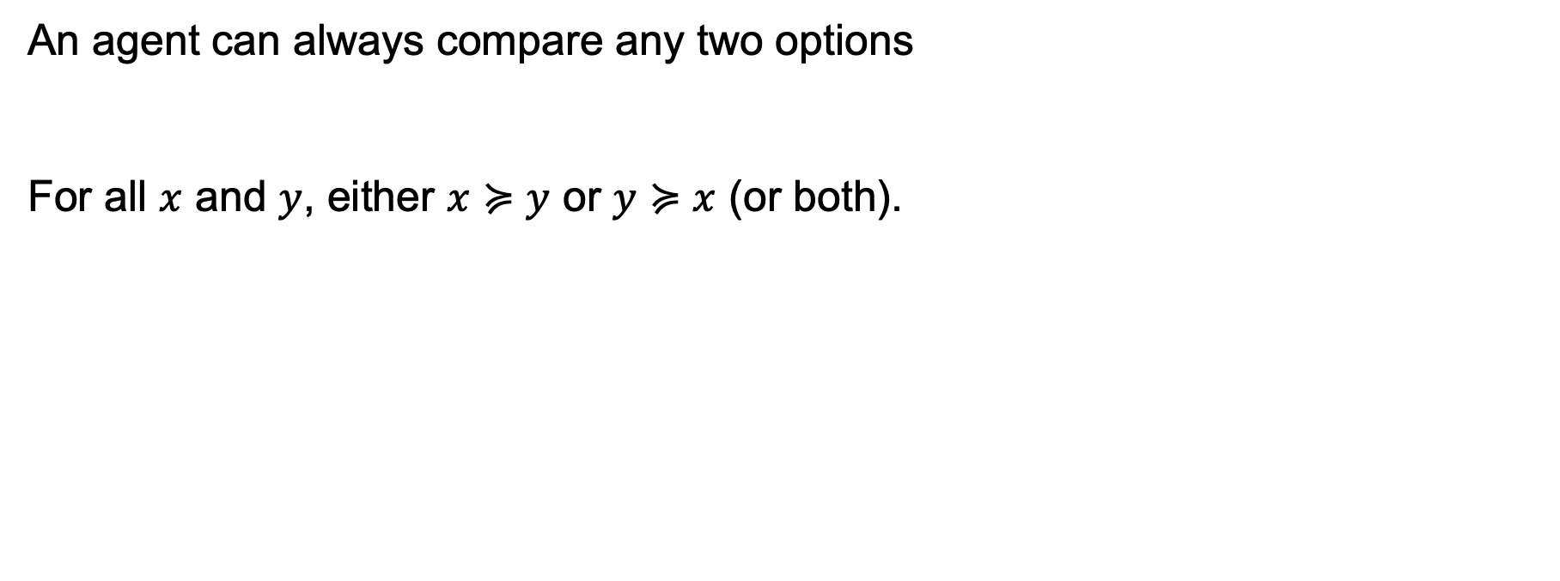
Completeness
An agent can always compare any two options
For all $x$ and $y$, either $x≽y$ or $y≽x$ (or both).

Slide 5
Transitivity
If a person prefers A to B and B to C, they will prefer A to C.

Slide 6
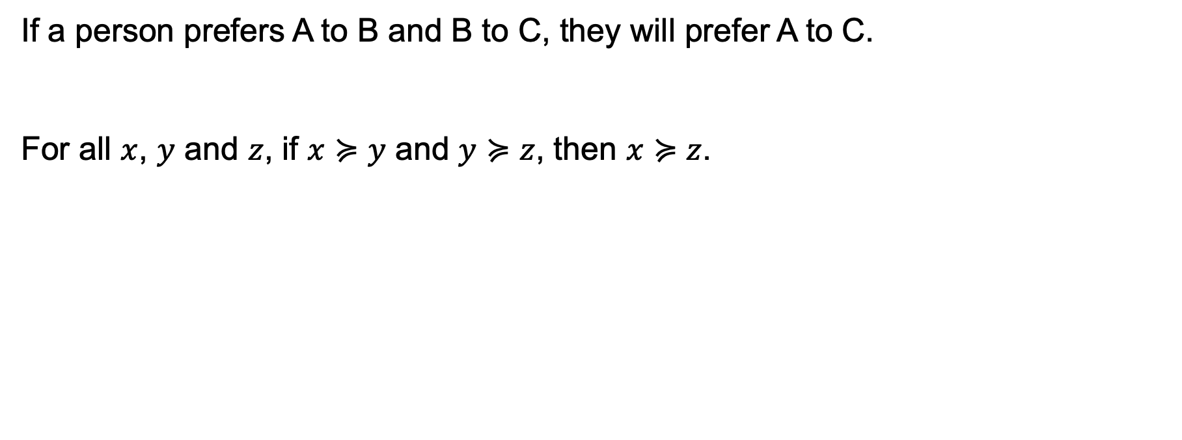
Transitivity
If a person prefers A to B and B to C, they will prefer A to C.
For all $x$, $y$ and $z$, if $x≽y$ and $y≽z$, then $x≽z$.

Slide 7
Transitivity
A
$20
≻
≻
C
B
≻

Slide 8
Transitivity
A
$19
≻
≻
C
B
≻

Slide 9
Transitivity
A
$18
≻
≻
C
B
≻

Slide 10
Transitivity
A
$17
≻
≻
C
B
≻

Slide 11
Preference ordering
Completeness: One ordering

Slide 12
Preference ordering
Completeness: One ordering
Transitivity: No cycles

Slide 13




Slide 14
Independence of irrelevant alternatives
A new option shouldn't flip how you rank two existing options.

Slide 15
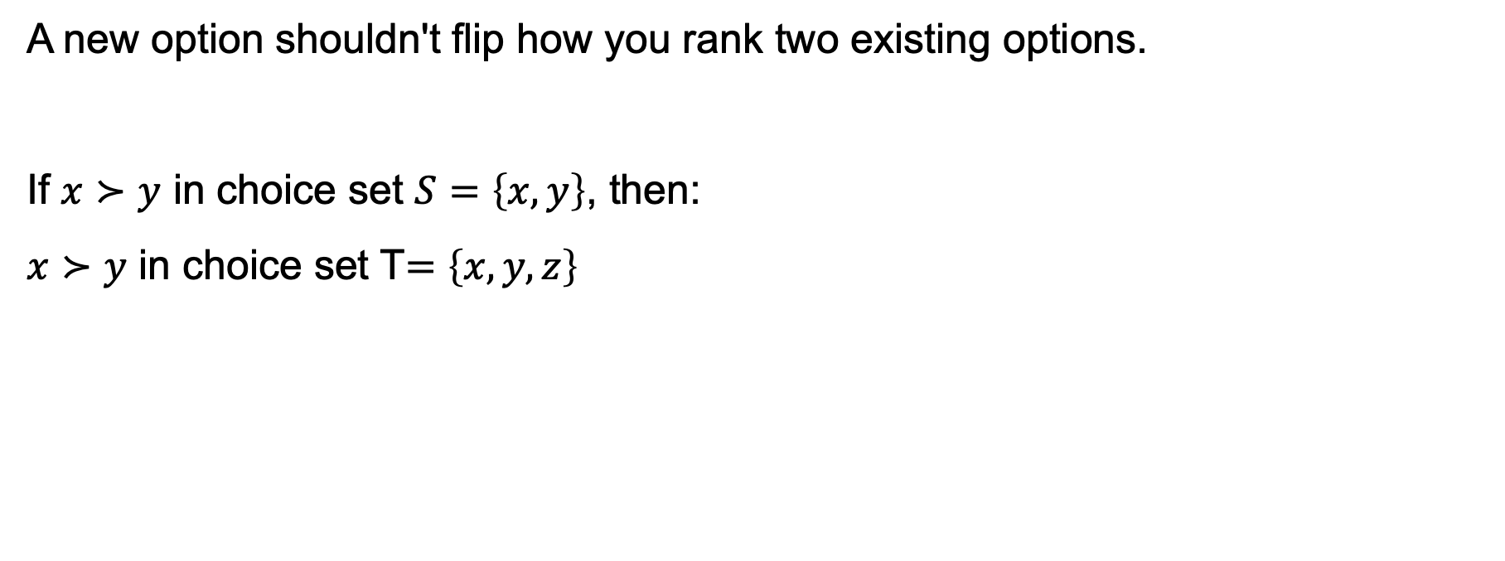
Independence of irrelevant alternatives
A new option shouldn't flip how you rank two existing options.
If $x≻y$ in choice set $S=\left\{x,y\right\}$, then:
$x≻y$ in choice set T$=\left\{x,y,z\right\}$

Slide 16
Independence of irrelevant alternatives
Context independent
Simplifies economic models
Avoid manipulation

